Slide 1
BARRIERS FOR INTERNATIONALIZATION
Canary Islands - Africa

Slide 2
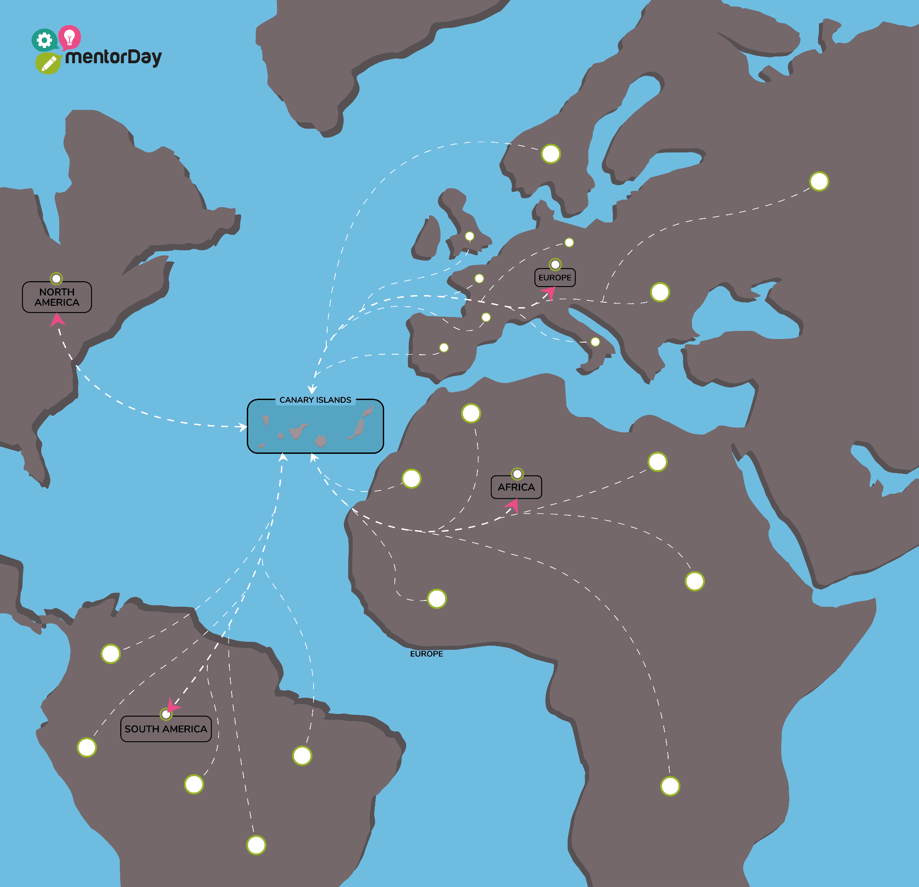
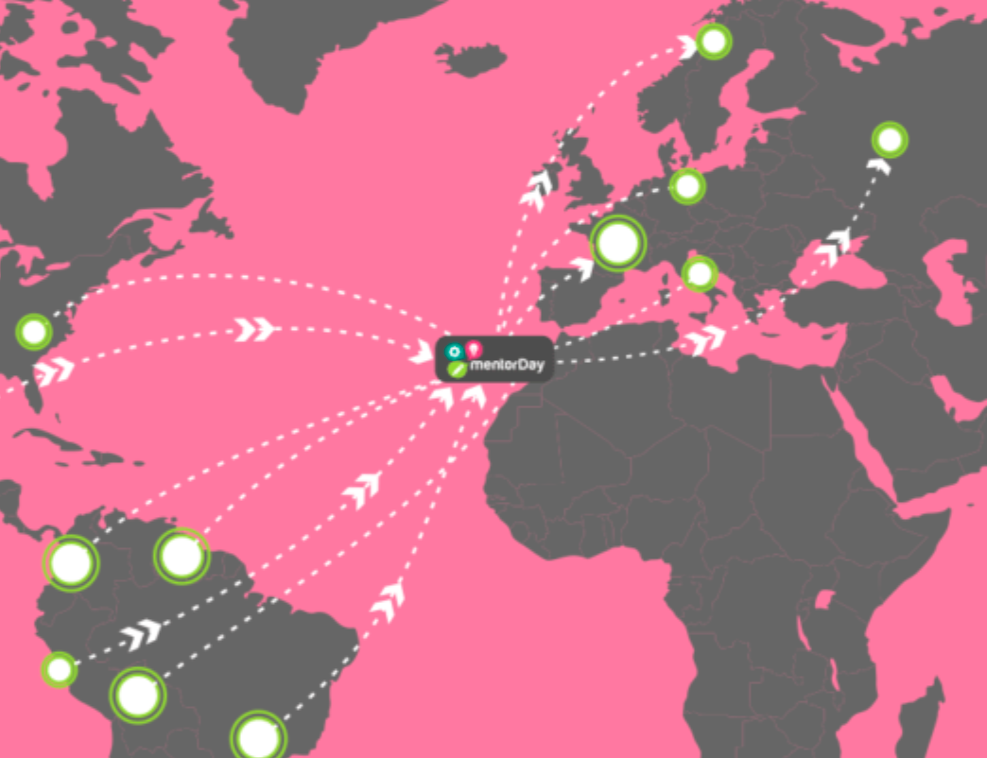
BACKGROUND
International Expansion: Canary Islands and African companies.
Challenges: Needs and obstacles in internationalisation.
Canary Islands: Tricontinental hub for startups.

Slide 3
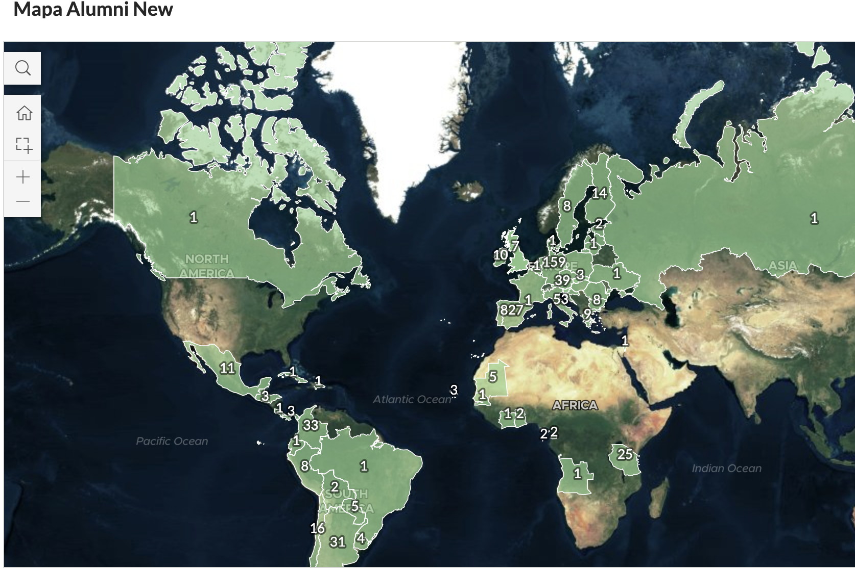
Canary Islands - Africa

Slide 4
¿Why mentorDay?
NGO with Global Impact: +1400 entrepreneurs supported in +50 countries.
Network of +3000 Volunteers: Mentors, advisors, funders.
Entrepreneurship and Quality Employment: Focus on successful businesses and the creation of quality employment.
Global Recognition: Top 5 global accelerators by UBi global network.
BAP oro, PROEXCA

Slide 5
OBJECTIVES OF THE STUDY
Identify: Main needs and obstacles.
Develop: Effective support tools
Share: Knowledge for business growth

Slide 6
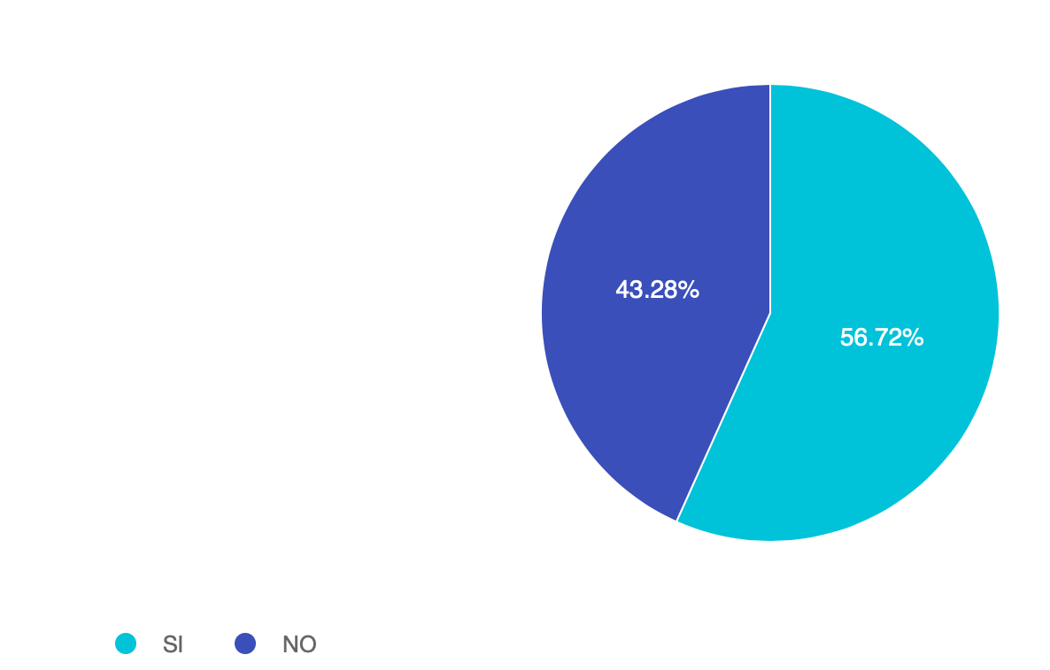
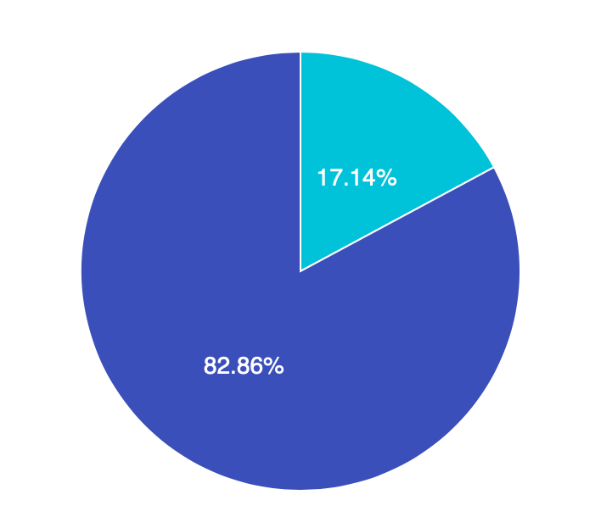
EMPRESAS EXPORTADORAS:
Africa
Canary
Notes:
Aclarar que es la muestra de empresas encuestadas

Slide 7
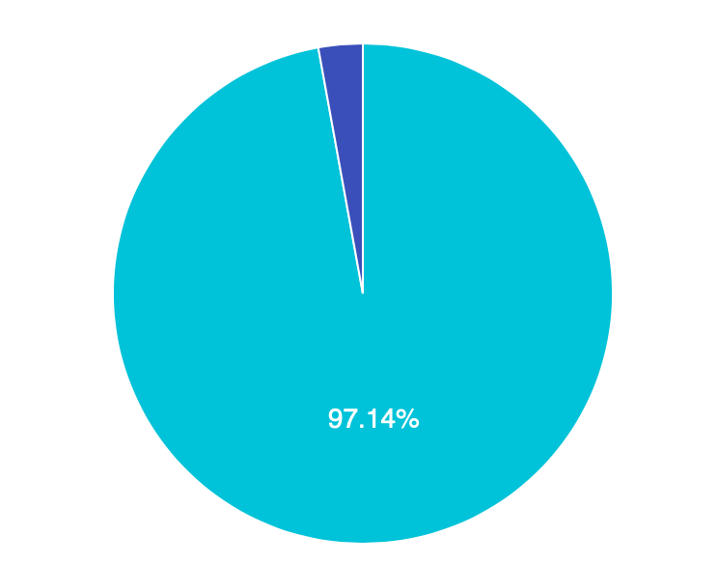
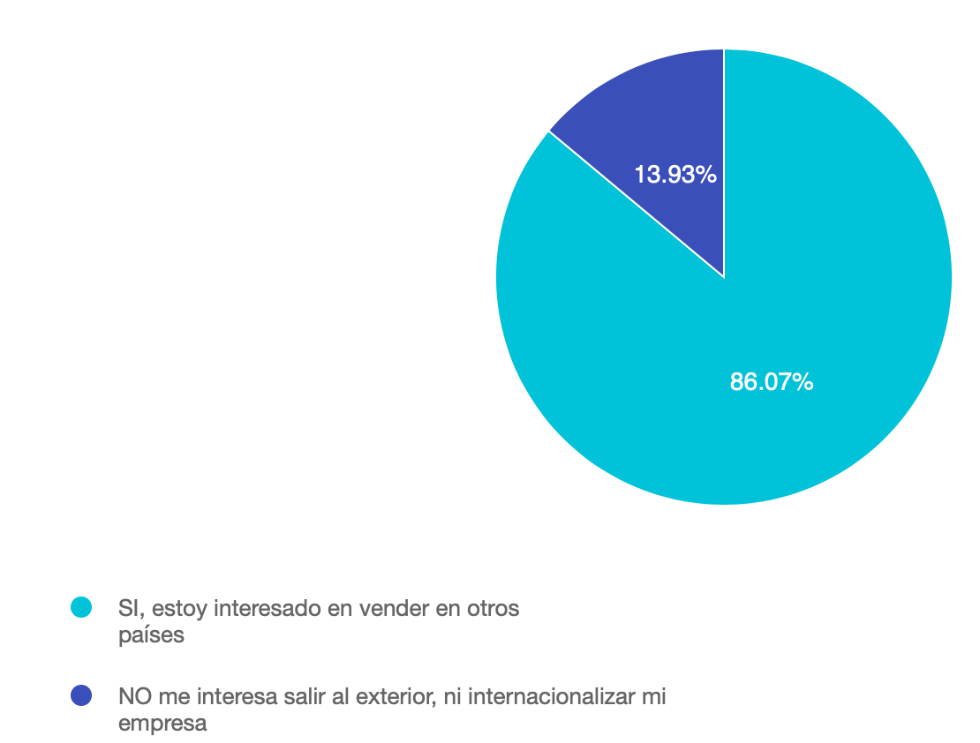
¿Interested in selling abroad?
Africa
Canary

Slide 8
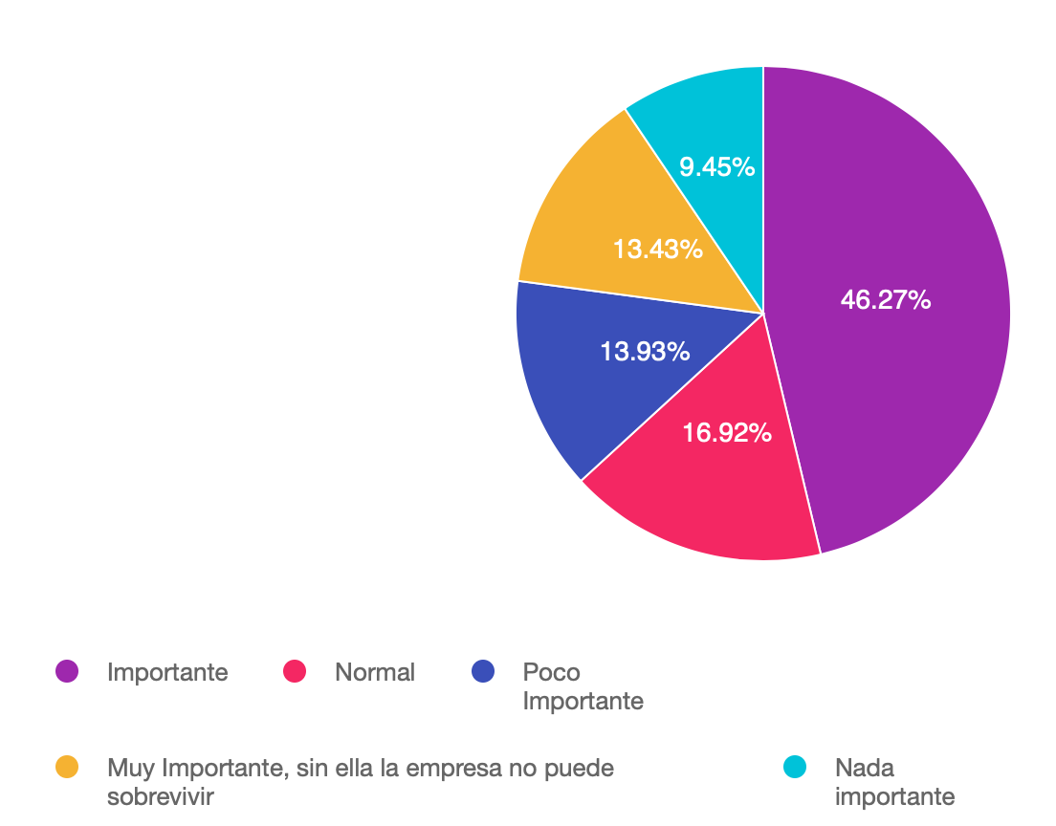
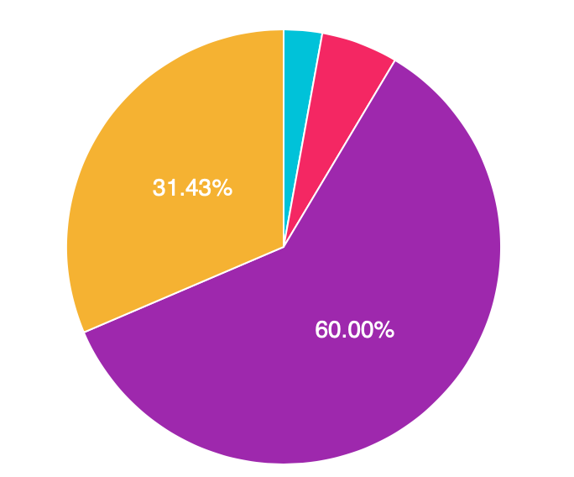
¿How important is international commerce?
Africa
Canary
Notes:
Las africanas ven internacionalización mas importante (90% frente al 61%)

Slide 9
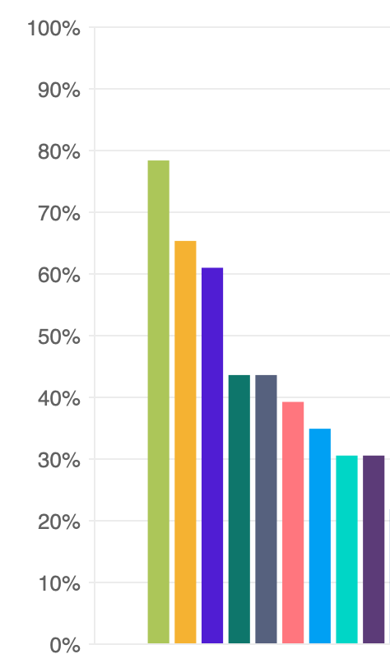
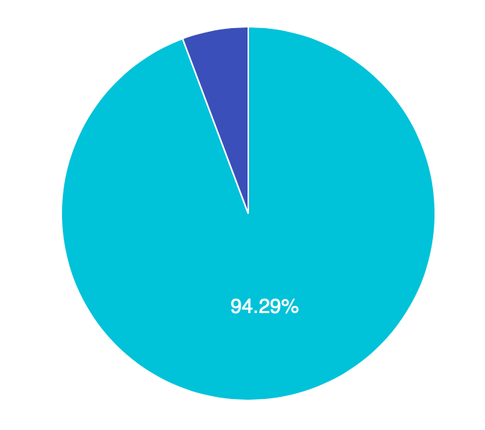
African companies interested in selling to Europe:

Slide 10
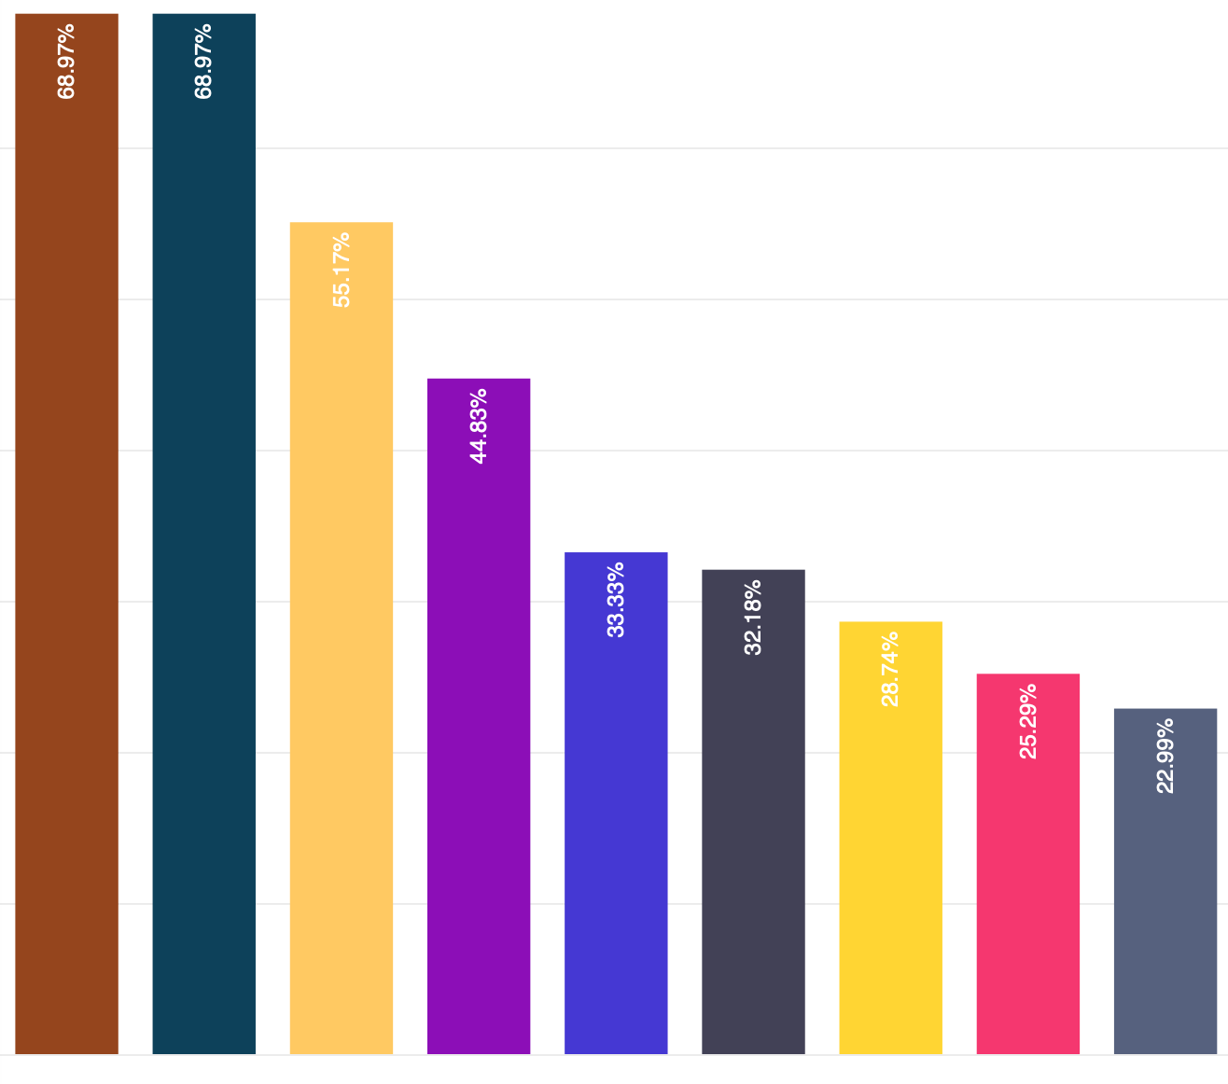
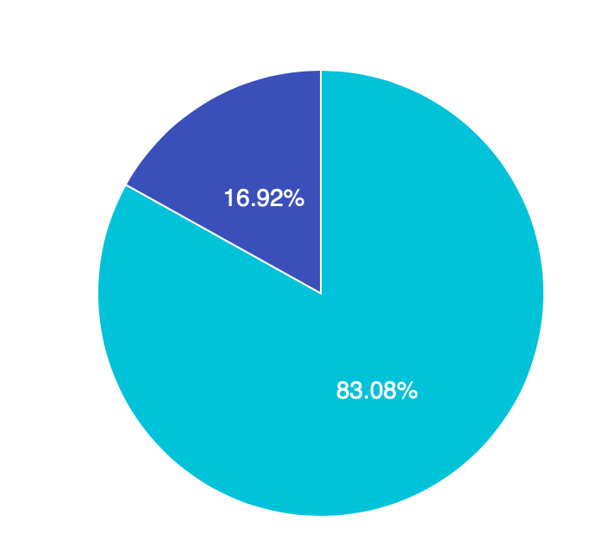
Canarian companies interested in selling to Africa:

Slide 11
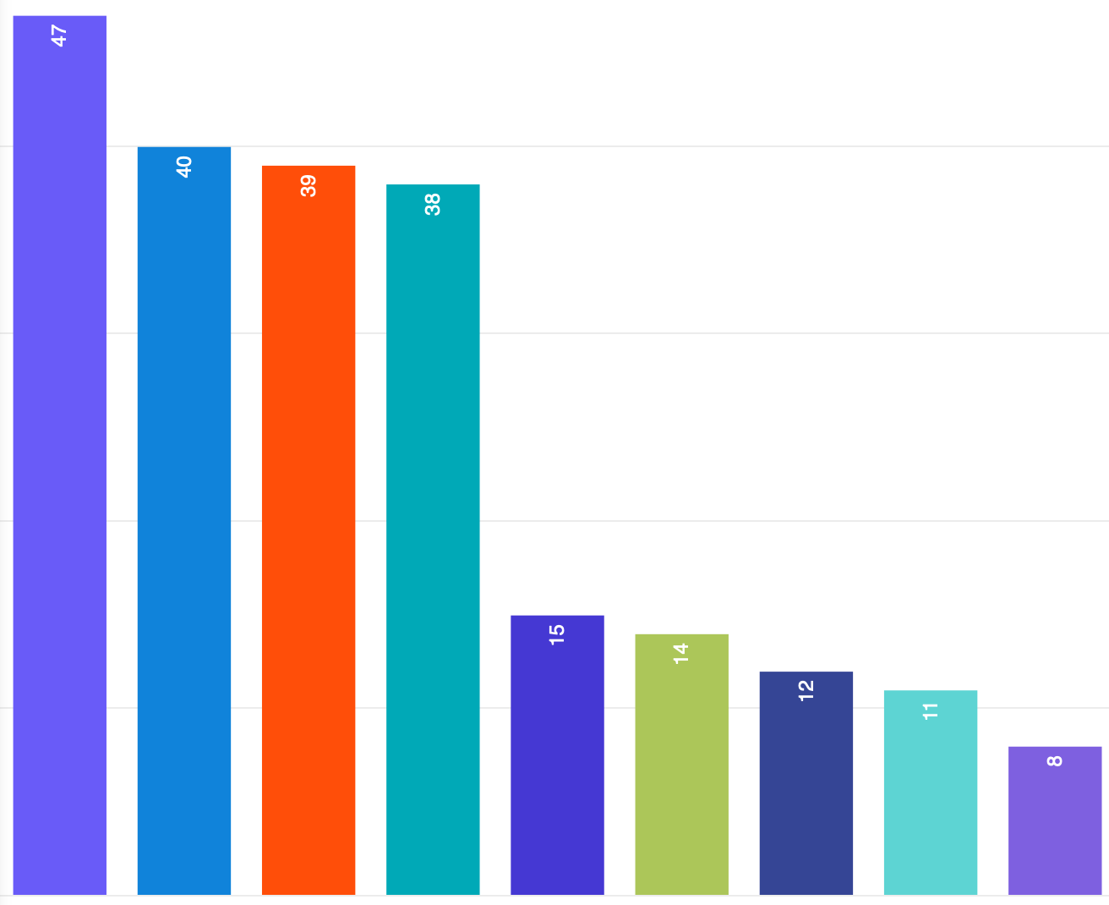
Where do Canary companies sell?

Slide 12
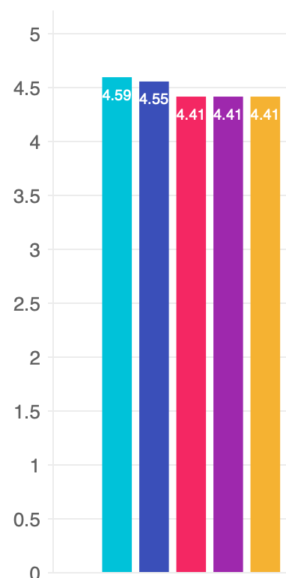
Barriers for Internationalization - African companies
Finding the right legal form
How to relate to each customer in each country (export, agent, own establishment...)
Analyse the economic viability and profitability of internationalisation.
Obtaining guarantees (for tenders)
Documentation, customs obstacles at destination

Slide 13
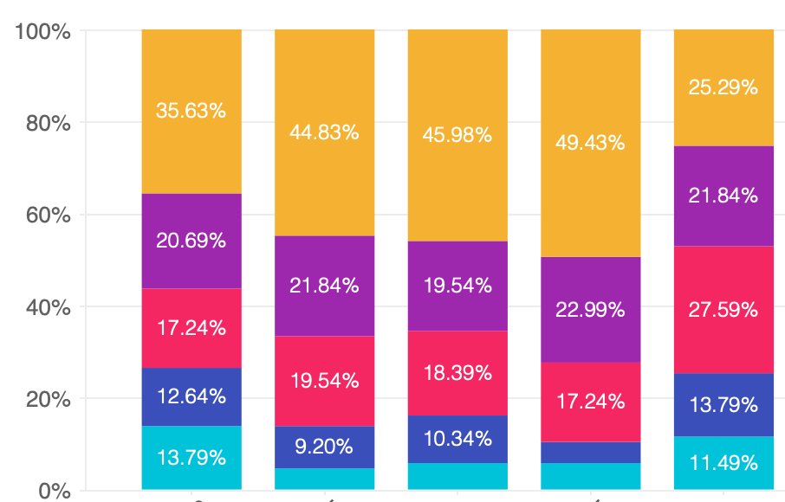
Barriers for Internationalization - Canarian companies
Searching for local partners
Finding the right communication channel with customers in each country
Identifying my customers in each country
Identifying opportunities in countries
How to relate to customers in each country (export, agent, representative, own establishment)

Slide 14
Institutions Service Needs:
African companies:
Organising trade missions
mentoring
Solving logistical and customs problems
Specific market knowledge
Creating contac agendas
Canary companies:
Create a contact agenda
Search for opportunities in each country
Have an institutional contact in the destination country to provide information
Subsidies
Identification of partners.

Slide 15
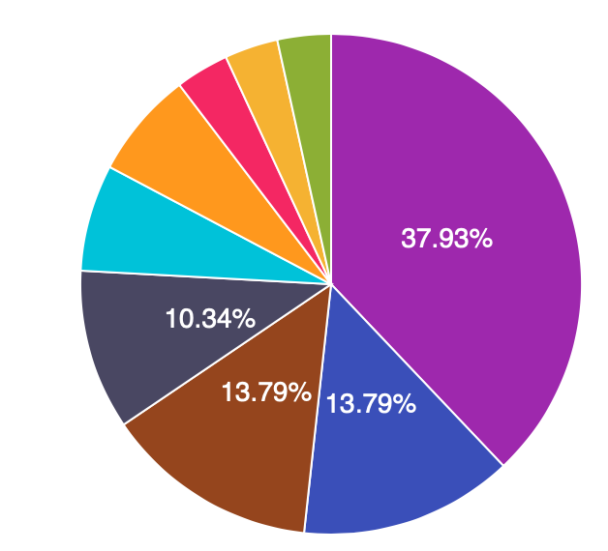
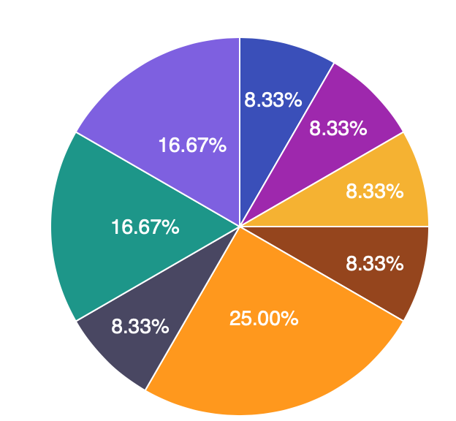
What sustainability training do they value?
Agriculture and sustainable production
Circular economy and waste management
Sustainable finance and corporate responsibility
Sustainability regulations and policies
Africa
Sustainable leadership and organisational change
Other
I don't consider any necessary
biodiversity and ecosystems
Canary

Slide 16
Main NEEDS with solution
Personal training
Access to contacts
Specific market knowledges
Consulting doubts with experts
Financial access, investors.
mentoring and acompanion

Slide 17
TOOLS For Needs: “Personal training”
:
Needs Assessment survey (new IA)
mentorFit
DailyTips
mentoring

Slide 18
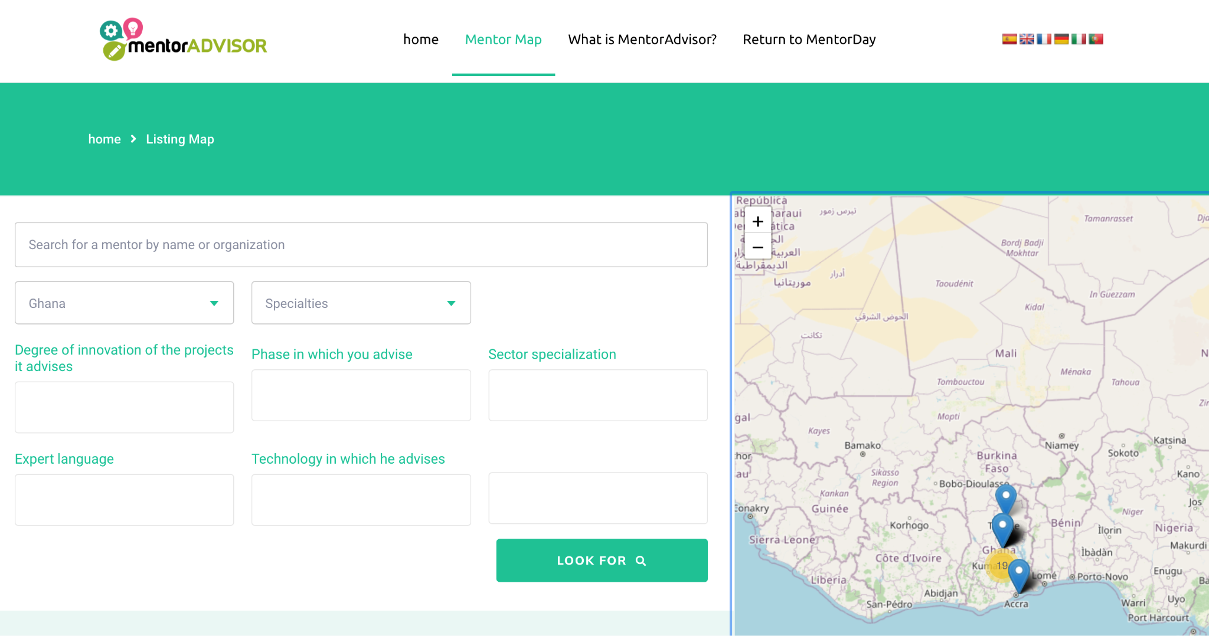
TOOLS For Needs: “access to contacts”:
“ “
mentorAdvisor
Networking

Slide 19
TOOLS Needs: “Specific Market Knowledge”
:
Ecosystem Maps

Slide 20
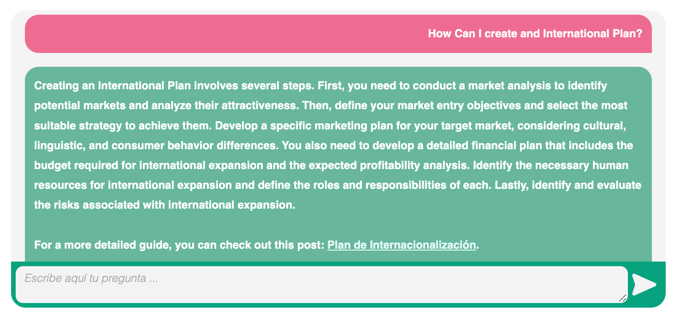
TOOLS Needs: “Consulting doubts with experts”
Need to address questions on internationalisation and other aspects relevant to international growth:
WikiTips
mentorVirtual
Speed Mentoring

Slide 21
TOOLS For Needs: “Access to financial, investors”
Need to improve financial capabilities:
mentorCoinvierte

Slide 22
TOOLS For Training/International Push /Accompaniment
Softlanding Program

Slide 23
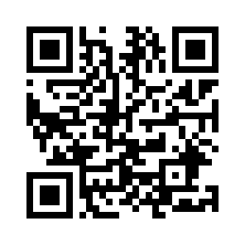
THANKS and Welcome
we're delighted to also accelerate the internationalization of your company
REGISTER HERE:
mentorday@mentorday.es

